Slide 1
Welcome to our class

Slide 2
Watch a video clip and answer the questions

Slide 3
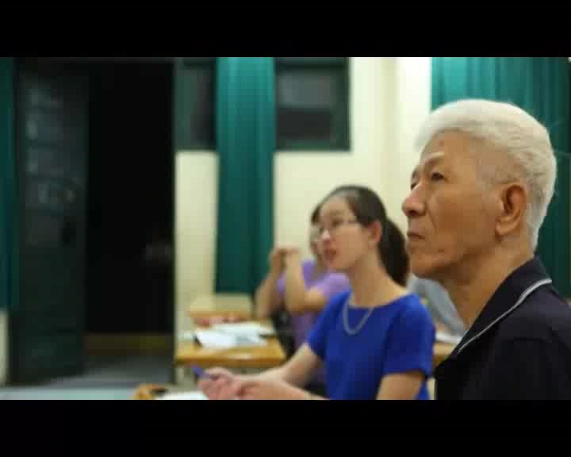

Slide 4
1. What do you think about the old man in the video?
2. He still learns at the age of 71. So what kind of learning is it?
→ Lifelong learning

Slide 5
UNIT 10: LIFELONG LEARNING
Lesson 1: Listening
Keep learning throughout life

Slide 6
Task 1. Angela and her grandpa are talking about keeping learning throughout life. Listen and read.
Angela: Grandpa, sorry I'm a bit late, but I had to do a lot of homework and missed the bus. If I hadn't missed it, I'd have come at least 30 minutes earlier.
Grandpa: No problem. Your grandma is still out shopping.
Angela: What are you reading, grandpa? You look really excited!
Grandpa: Well, I've joined the Lifelong Learning Institute and I've chosen some interesting courses to attend. Do you want to have a look at their brochure?
Angela: OK. But I thought you are retired now?
Why do you need to study? And what's this lifelong learning? Do you mean learning all the time?
Grandpa: Kind of ... These courses are not just for retired people. They are for everyone who is interested.
Angela: Oh, no, I don't think I'd want to study all my life. Twelve years in compulsory education seems enough for me.
Grandpa: Yes, but things change all the time. There are new ideas and concepts that you need to understand in order to succeed! As a lifelong learner, you can also choose what and how to study. This type of learning is self-directed.
Angela: Sounds great, but how can I find the time to attend courses when I have a full-time job?
Grandpa: Well, you could do an online course with discussion sessions in the evening or at the weekend. You can do it from the comfort of your own home. The key thing is to enjoy learning and acquire new skills all the time.
Angela: Sounds nice. So lifelong learning is all about learning to enjoy learning?
Grandpa: That's right. It's voluntary and self­motivated. People usually take time to study for personal or professional reasons, depending on their needs and learning styles.
Angela: But what about you? Why do you need to do all these courses? Digital technology, art history, French literature? These courses all sound difficult to me. If I had known that, I'd have brought you my Information Technology textbook.
Grandpa: Well, it's important for me to try new things and keep my brain healthy and fit. I can also meet and talk to different people, and make new friends.
Angela: Good luck, grandpa. Hope you enjoy the courses.

Slide 7
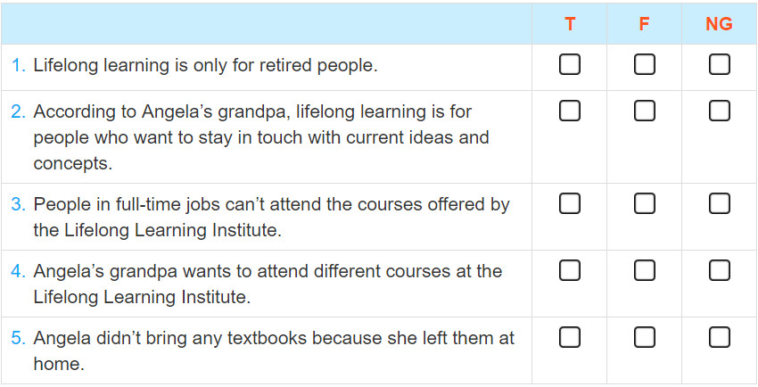
Task 2. Work in pairs. Decide whether the following statements are true (T), false (F), or not given (NG). Tick the correct box.
v
v
v
v
v

Slide 8
Task 3. Match the words in A with their meanings in B.
Words | Meanings
1. Compulsory education | a. These are ways and techniques of learning something.
2. lifelong learning | b. This includes all activities that aim at improving knowledge and skills throughout life.
3. self-motivated | c. This kind of education requires children to attend a state or private school to complete a certain period or level
4. self-directed | d. This word is used to describe people who are keen to do or achieve something because of their own enthusiasm or interest.
5. learning styles | e. This word is used to show that lifelong learners can choose freely what to learn.

Slide 9
Vocabulary
- Compulsory education (n.phr)
Giáo dục bắt buộc
- Lifelong learning (n.phr)
- Self-motivated (adj)
- Self-directed (adj)
- Learning style (n.phr)
/kəm'pʌlsəri/
/,edjʊ'kei∫n/
/'laiflɒη/
/'lɜ:niη/: Học tập suốt đời
/self/
/'məʊtiveitid/: Động lực
/self/
/di'rekt/: Tự định hướng
/'lɜ:niη/ /stail/
Phong cách học tập

Slide 10
Task 4. Work in pairs. Ask and answer the question.
Do you think lifelong learning is important? Why? Why not?

Slide 11
Task 5. Work in pairs. Discuss the form and meaning of the grammar point in the following sentences.
1. If I hadn't missed it, I'd have come at least 30 minutes earlier.
2. If I had known that, I'd have brought you my Information Technology textbook.
Answer key

Slide 12
Homework
Learn all the new vocabulary by heart
Prepare the new lesson - Language

Slide 13
Thank you

